Slide 1
Aura HRMS (Human Resource Management System)
404 Founders | CIEL Kingston vibeAIthon 2025

Slide 2
“Show. Don’t tell. Bring your idea to life!”

Slide 3
Problem Recap & Objective
Summary:
HR teams in mid-to-large-sized organisations struggle with fragmented, manual, and disparate systems for managing the Employee Lifecycle, leading to inefficiencies, reporting errors, and compliance risks. Furthermore, the shift to hybrid/remote work requires better location-based attendance and digital asset management, while increased regulatory scrutiny necessitates rigorous audit and contract management tools.
Key pain points:
Wasting time on administrative tasks (like generating Performance, Attendance, Payroll, and Training reports) by HR Managers/Generalists.
The lack of a single, intuitive Employee Self-Service Portal for employees in complex workforces.
The cost and complexity of integrating multiple software systems (HRIS, CMS, and Asset tracking).
The risk of non-compliance due to manual processes.
Objective:
The objective is to demonstrate a unified, modular AI-Powered HRMS that centralises Employee Lifecycle Management (ELCM), complex reporting, and compliance into a single, intuitive platform.
Expected outcomes include:
Reduced HR administrative time through automated complex reporting and policy application.
Risk reduction of non-compliance via the HR Compliance Audit (HCA) and automated Contract renewal Alert.
Providing a single platform to eliminate the cost and complexity of integrating multiple, separate software systems.

Slide 4
Prototype Overview
Technology
Frontend: React/Vue.js
Backend: Node.js(Server), Express, Python (Django/Flask)
Database: PostgreSQL
Hosting: AWS

Slide 5
User Experience & Impact
Walk through a simple user journey
Show key features or interactions
What makes your approach unique or innovative?
Outline next steps for scaling or refining the prototype

Slide 6
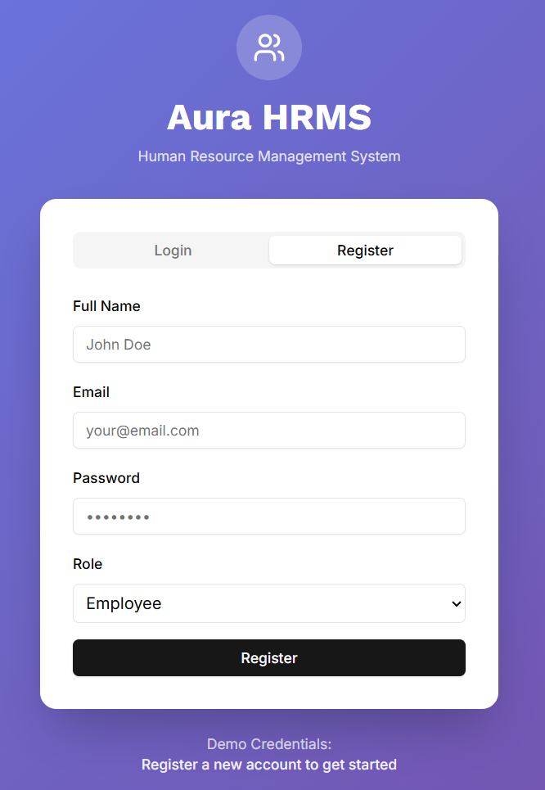
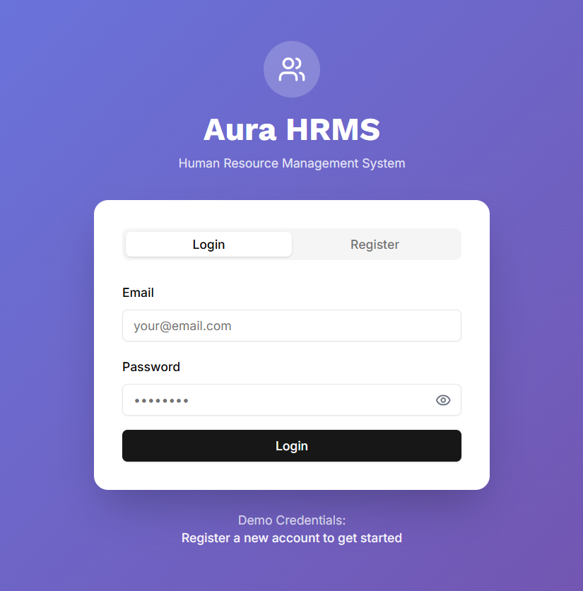
Screenshots & Wireframes

Slide 7
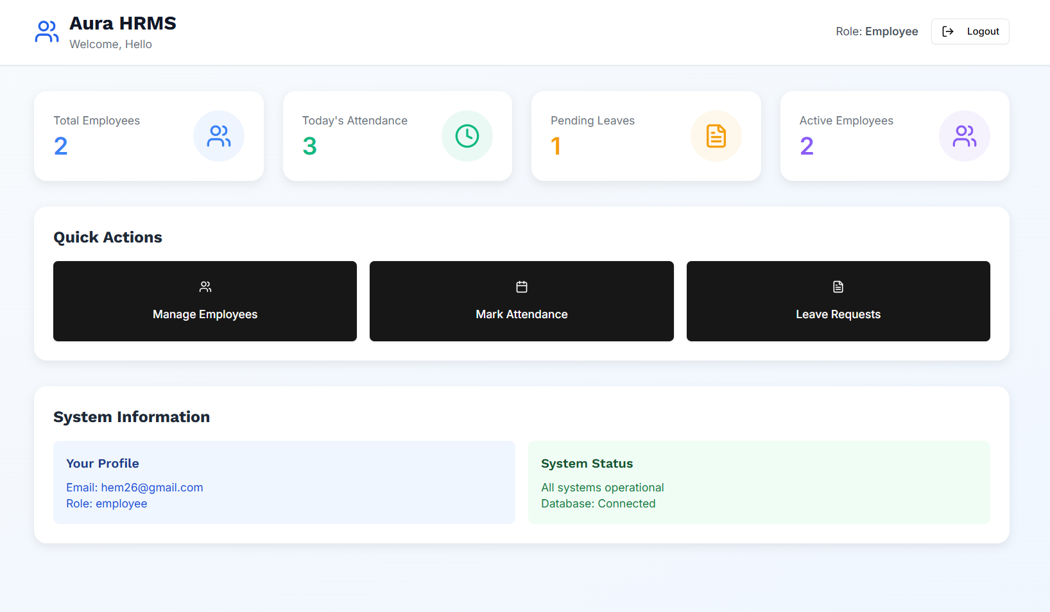

Slide 8
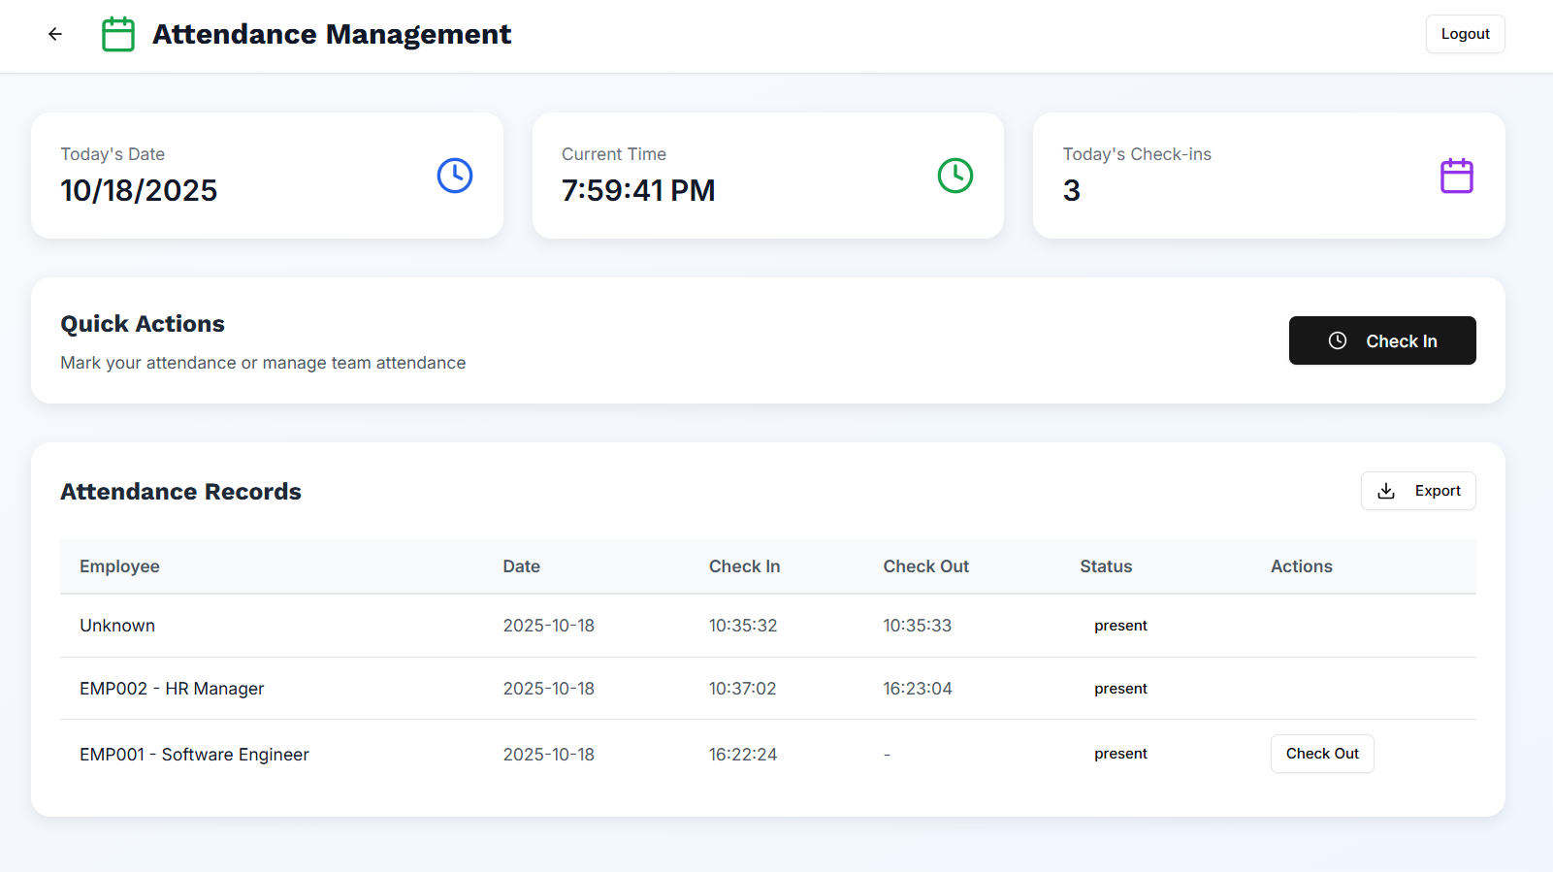

Slide 9
